Slide 1
Social media playbook for iiba chapters

Slide 2
"If your IIBA chapter isn't leveraging social media, you're not just missing out—you're losing opportunities to grow your community, connect with aspiring and seasoned Business Analysts, and showcase your value.
Social media is the modern hub for collaboration, knowledge sharing, and expanding your chapter's reach. Without it, you're leaving potential members and partnerships untapped."

Slide 3
What We’ll Be Covering...
Optimal Posting Times
- What’s the best times, days to post on LinkedIn?
Audience Engagement
How do you engage your audience with your social media posts?
Best Practices for Tagging
- Who should I tag? Who can I tag?
Content Creation Strategy
- How often should I post? What should I post about? How do I go about creating content?

Slide 4

Optimal posting times on Linkedin
Let’s Nail This!

Slide 5
When’s the Best Time to Post on LinkedIn?
Best Days to Post: Midweek – Tuesdays, Wednesdays, and Thursdays. (your local time)
Best Times to Post: 7.30am – 9.30am, 12pm – 1pm,
and 5 – 6pm. (your local time)
Things to Consider:
Demographics of your audience: Are they students? Or do they work 9-5?
Keep an eye out on your best performing posts! Noticed that certain posts work better on certain days or times? Do what works for your LinkedIn account!

Slide 6

aUDIENCE ENGAGEMENT
The Post is Goin’ to Get Lit!

Slide 7
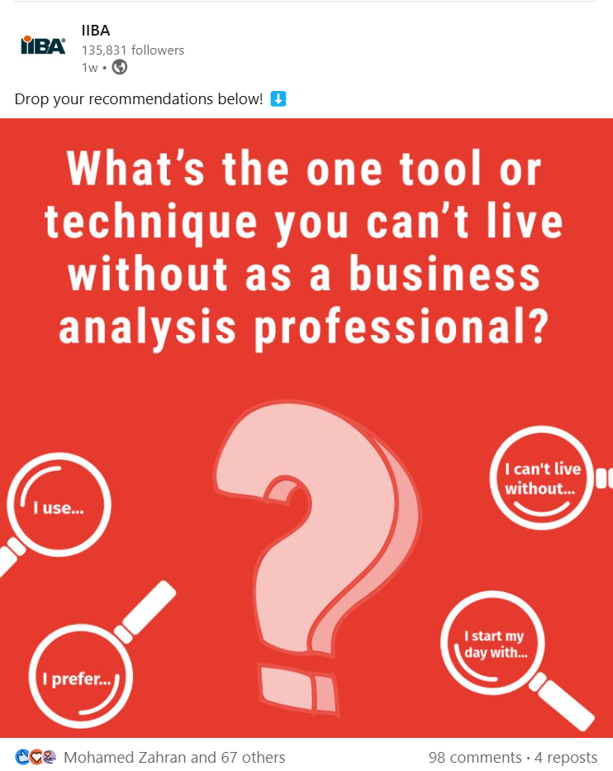
Audience Engagement - Strategy 1:
Ask Questions
Ask open-ended questions to foster engagement. People often enjoy sharing their professional thoughts and opinions on LinkedIn.
Social Media Caption Templates:
“What’s the biggest business analysis trend you’re seeing this year?”
“Tell us one thing you’ve learned at a recent conference…”
“What’s the first thing we need to know about Agile?”
Of course, have them hashtag AND tag your chapter (e.g. #IIBAPalmettoChapter, and #IIBA) in the comments, along with their answers.
Notes:
The logic: the more engagement you get on your post, in a shorter period, the more visibility your post will generate, based on LinkedIn’s algorithm.

Slide 8
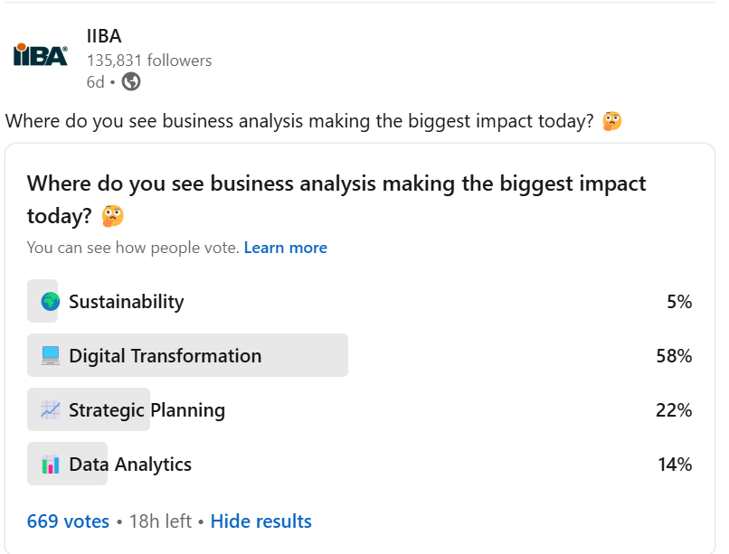
Audience Engagement - Strategy 2:
Polls & Quizzes!
Want to do a little research on your audience/chapter members? Do a poll!
Poll Templates:
“Do you prefer an in-person study group or a virtual one?”
“What are some of the best times to conduct the study group?…”
“What additional offerings would you like to see from your IIBA Chapter??”
Quizzes:
Ask a question – perhaps a question from the BABOK Guide v3 or any of the member resources, and for fun, throw in a little giveaway like a digital pdf asset or IIBA swag!
Notes:
The logic: you don’t need to always fret over what your members are looking for or would like to know more of. Ask them directly on a post through polls.
Give back and spice your social media account up by running quizzes and little giveaways. Fun and light hearted stuff like this can be applied to other social media platforms too such as Instagram & Facebook.

Slide 9
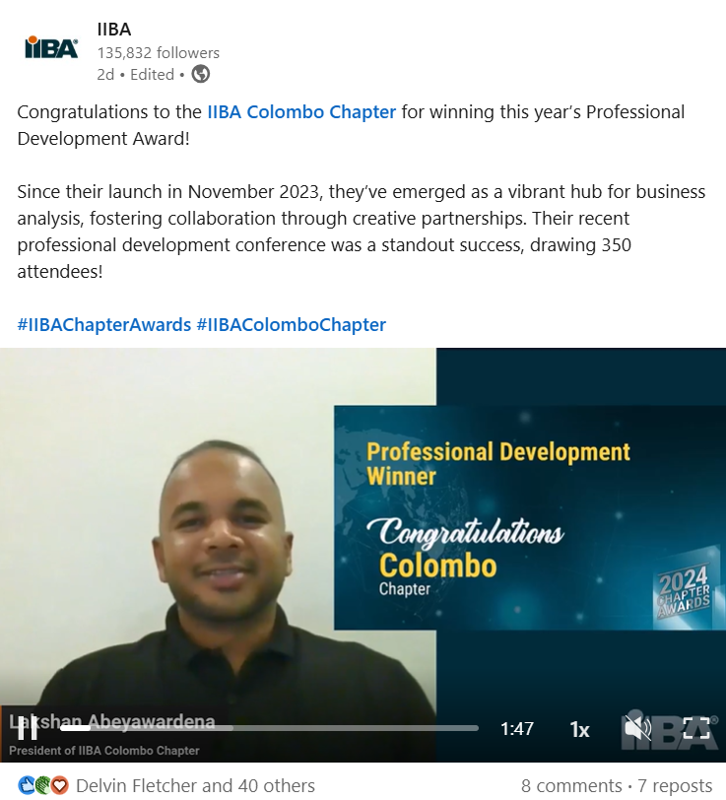
Audience Engagement - Strategy 3:
Share Success Stories!
If there’s one thing, we’ve realized over the years… our members, volunteers, and the entire business analysis community are big cheerleaders and enthusiastic supporters!
So… go right ahead and share that success story of that well deserving volunteer/member!
Notes:
The logic: We are a community of business analysis professionals, just like you, who apply business analysis in our daily roles. We look to each other to elevate the profession to the next level. So it only makes sense for us to support one another by sharing success stories and learning together.

Slide 10

BEST PRACTICES FOR TAGGING
Tag Away? Yeah, no.

Slide 11
DO’s
DON’Ts
Use relevant hashtags to make your post more discoverable. E.g. #BusinessAnalysis #IIBA #IIBAMumbaiChapter
Keep hashtags between 3 – 5 per post. Ideally.
Research trending or niche hashtags using LinkedIn’s search bar feature. View image here.
Create and promote branded hashtags. E.g. #BBCConf #BABeyond #IIBABrusselsChapter
Tag individuals/companies/organization/event speakers and participants relevant to the post. Tag & Hashtag IIBA on all your posts!
Respond promptly to comments by individuals/organizations tagged in the post. Doing so will help post generate visibility.
Engage with posts you’re tagged in.
Over tag/tag an individual/organization simply for
attention or promotional purposes.
Tag more than 6 individuals/organizations in a post unless it’s absolutely relevant such as when you’re referring to a conference agenda
Ignore posts you or your chapter are tagged in.
Put up a post without hashtags or tags. You’re missing out on opportunity to help your post with visibility.
Forget to tag IIBA on all your posts!
Forget to tag/check in to a location especially if it’s a large conference!
Notes:
The logic: Tagging, using hashtags and location tags can all help to boost the visibility of our social media posts, but there are some do’s and don’ts around it.

Slide 12
Content strategy
Content is King… if you don’t already know.
Notes:
The logic: Often, many refrain from posting on social media because they “don’t know what to talk about”. Having content pillars will solve this issue and help you plan out your content better throughout the week/month.

Slide 13
Content strategy 1: content pillars
Pillar 1: Educational
The Educational pillar consists of content designed to enhance the reader’s knowledge and provide valuable insights.
Content consists of thought leadership insights about Business Analysis trends, tools, techniques, tips, best practices, latest research & more.
Content Template Examples:
“Here are 5 tips to prepare for the CBAP certification”
“The recent Global State of Business Analysis by IIBA showed that….”
“#PestelAnalysis is a tool that helps identify external factors that could impact a business… read more:”
“A recent blog post from IIBA’s Analyst Catalyst discusses the 5 ways you can gain analysis experience.. Read on….”

Slide 14
Content strategy 1: content pillars
Pillar 2: Promotional
The Promotional pillar focuses on content such as promoting chapter events, study groups, webinars, certifications, membership & more!
Although this pillar is a straight up promotional one, always try to keep it as interesting/engaging as possible.
Content Template Examples:
“Our upcoming webinar talks about X topic. What do you think about X topic? Join us in discussing this, on our upcoming webinar: <insert link>”
“Are you preparing for the Agile Analysis certification? You don’t have to do it alone! Join our chapter study group on X date X time…”
“Join IIBA as a member and it’ll open your doors to endless business analysis resources and what our Chapter has to offer…”

Slide 15
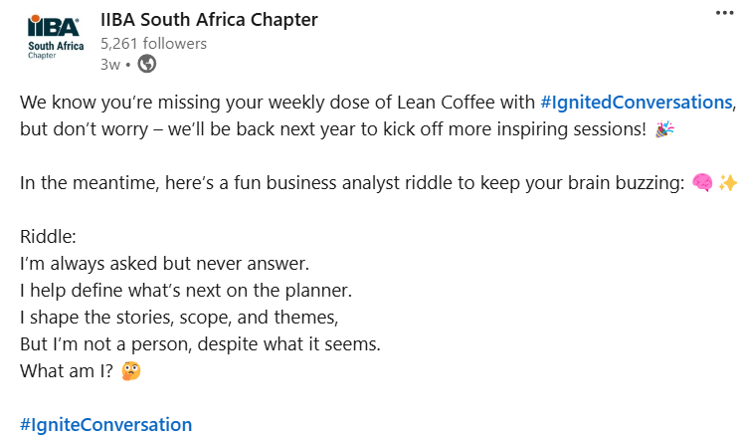
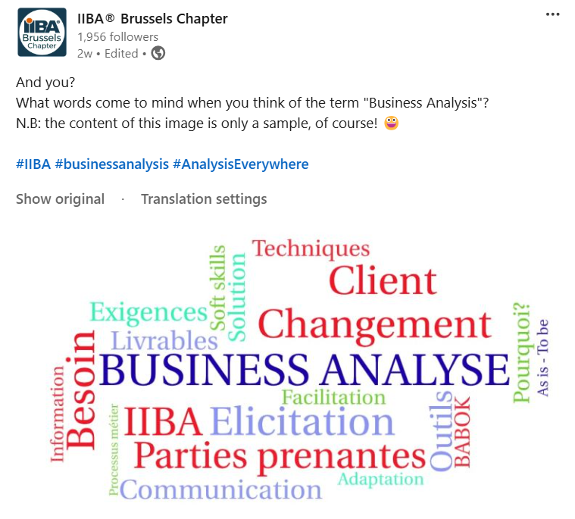
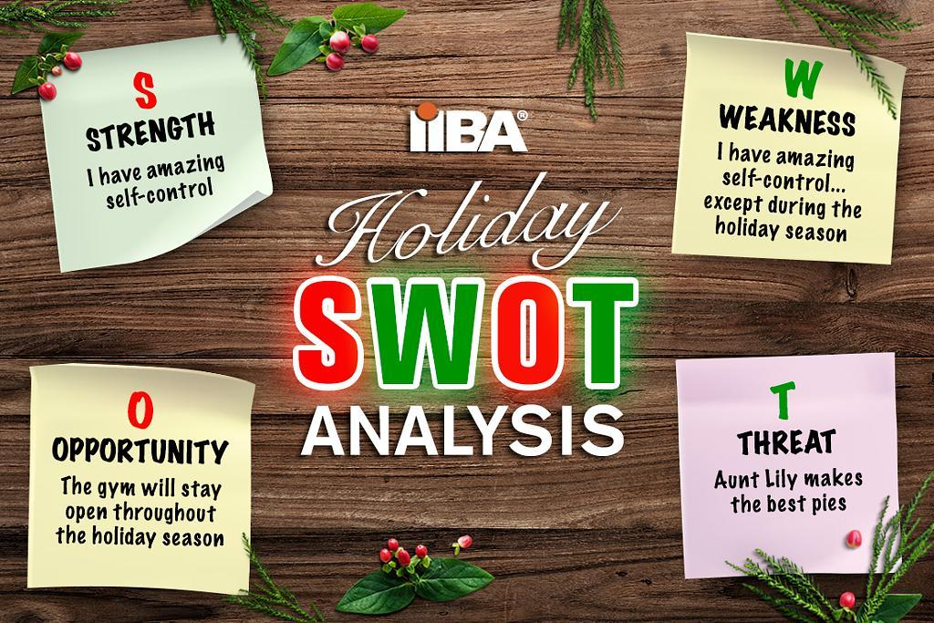
Content strategy 1: content pillars
Pillar 3: Engagement
The Engagement pillar consists of content that’s light-hearted, engaging of course, and designed to generate responses from the reader.
Some examples that can be classified under the engagement pillar are business analysis memes/jokes, quizzes and polls, open-ended questions, and others that have been discussed earlier in this deck.
Content Examples:

Slide 16
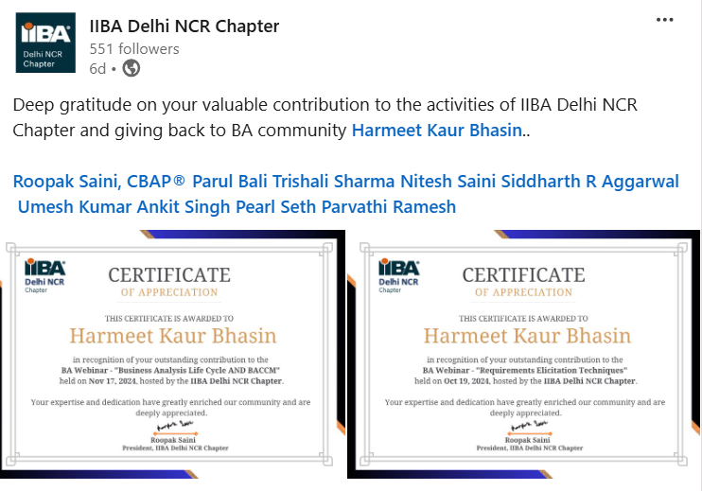
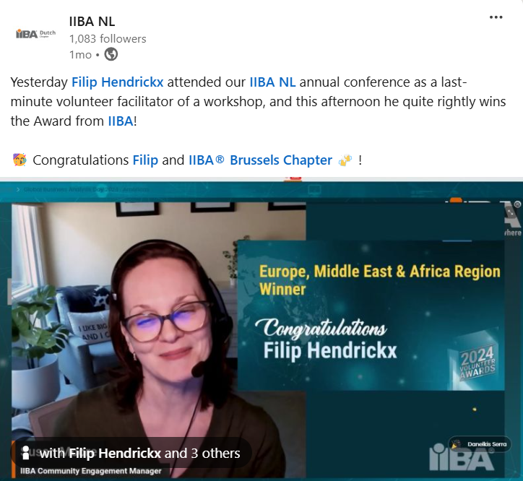
Content strategy 1: content pillars
Pillar 4: Community
The community-focused pillar consists of content such as celebrating member’s achievements, shout-out to volunteers, chapter’s milestone, member’s testimonial, and more!
IIBA Chapters is all about the business analysis community – supporting individuals and helping them grow professionally through events, networking, mentorship and more.
Think of this pillar as a celebration of or giving back to the IIBA/business analysis community
Content Examples:

Slide 17
Content strategy 1: content pillars
Pillar 5: Analysis Everywhere
Global Impact:
Launched by IIBA in 2024, the "Analysis Everywhere" campaign highlights the universal importance and diverse applications of business analysis across various sectors and roles worldwide.
Community and Stories:
It focuses on sharing stories and amplifying the voices of business analysis practitioners, showcasing the profession's significant impact on organizations.
Get Involved on Social Media:
Share your business analysis story/journey, tag IIBA and #AnalysisEverywhere
Tell us what #AnalysisEverywhere means to you…
Connect with your local chapter to get your hands on the #AnalysisEverywhere orange ball
Head on to iiba.org/analysiseverywhere for many more ideas & downloadable graphics by IIBA

Slide 18
Content strategy 2: images, videos & link posts (Part 1)
Videos
Performance: Videos are the best performing type of post across all social media platforms.
Length: Keep videos between 20 to 60 seconds to maintain viewer engagement.
Quality: Videos can be shot on a smartphone, but ensure that your voice is audible and the lighting is sufficient for clear visuals. Use landscape instead of portrait where possible.
Images
Performance: Image posts are the second-best performing type of post and are commonly used.
Content: Share images from events, chapter gatherings, or create simple designs using tools like Canva.
Guidelines: Follow IIBA brand guidelines and colors for consistency.
Variety: Use infographics, charts, or quote cards to emphasize your message.

Slide 19
Content strategy 2: images, videos & link posts (part 2)
Link Posts
Definition: Link posts drive people directly to a URL using a caption and often show a link preview.
Usage: While it's good to have a mix of posts, use link posts sparingly as they are the least effective compared to video and image posts.
Emojis
Purpose: Emojis add personality to a post and can make it more engaging.
Usage: Use emojis sparingly, limiting to one or two per post to maintain professionalism.
Caution: Overuse of emojis can make a post look unprofessional and may suggest it was written by AI.

Slide 20
Content strategy 3: Collaborate with other chapters
As an IIBA Chapter, you are part of an incredible, interconnected global business analysis community. Emphasize the unity and global nature of IIBA in all your social media activities; such as collaborating between Chapters, sharing each other’s initiatives & content, and highlighting other chapter/regional/global events.

Slide 21
Content strategy 4: Provide value
Value-Driven Posts:
- Always aim to provide or add value with each post.
- Ask yourself, "How will this post benefit the reader?“
Beneficial Content:
- Share resources, tools, templates, and industry reports.
- Provide content that readers can use and learn from.
Exclusive Content:
Offer exclusive content such as member webinars and downloadable guides.
Highlight the unique value of being part of the IIBA community.

Slide 22
The End
To access the video version of
The Social Media Playbook for IIBA Chapters,
Click here

