Slide 1
IIBA Chapter Playbook
Strategic Planning

Slide 2
There are local chapters around the world that support our members and help them grow professionally through events, networking, and volunteer opportunities.
The playbook is designed to showcase the best practices chapters should follow to develop and document a strategic plan.
A strategic plan helps define and share the direction your chapter will take in the next three to five years. It includes your chapter's vision and mission statements, goals, and the actions you'll take to achieve those goals. Critical steps to Strategic Planning Include:
Purpose and Approach
Planning
Evaluation
Facilitation
IIBA Mission:
Lead the global business analysis community and professional standards so every person achieves more
IIBA Vision:
Shape the practice of business analysis to achieve better enterprise outcomes
IIBA Values:
We listen and are fair and act wisely as stewards and custodians of our profession
We are considerate, responsive, and treat everyone equally
We tell the truth, do what is right and follow through with excellence
We work together, learn from, and value each other

Slide 3




Agenda
Purpose and Approach
Planning
Evaluation
Facilitation

Slide 4

Purpose & Approach

Slide 5





Purpose
A strategic plan is a document used to communicate with the organization the organization's goals, the actions needed to achieve those goals and all other critical elements developed during the planning exercise.
It is created with deliberate intent and should be developed with the below in mind:

Slide 6

Purpose
Inputs
Inputs
Frequency
Strategic Planning Session Guide
Current State Metrics
Prior Year Chapter Scorecards
Chapter Bylaws
IIBA Strategic Plan
Participants
Publication
Relationships

Slide 7

Purpose
Inputs
Frequency
Frequency
Generated every 3 years, with an annual review for adjustments or alignment to changing market conditions and new Board members.
Since the Strategic Plan is typically an input to annual business, marketing and financial plans, it should be reviewed prior to those annual planning sessions.
Participants
Publication
TEMPLATE
Relationships

Slide 8

Purpose
Inputs
Frequency
Participants
Participants
Board of Directors
Program Leads, i.e., Event Coordinator, Mentoring Program Lead, etc.
Publication
Relationships

Slide 9

Purpose
Inputs
Publication
Frequency
The Strategic Plan should be available to all Chapter members in good standing.
Typically summarized in Chapter communications with a link to the actual document provided.
Participants
Publication
TEMPLATE
Relationships

Slide 10

Purpose
Inputs
Frequency
Relationships
Participants
The Strategic Plan is used as an input to:
Annual Business Plan
Financial Plans
Publication
TEMPLATE
Relationships

Slide 11
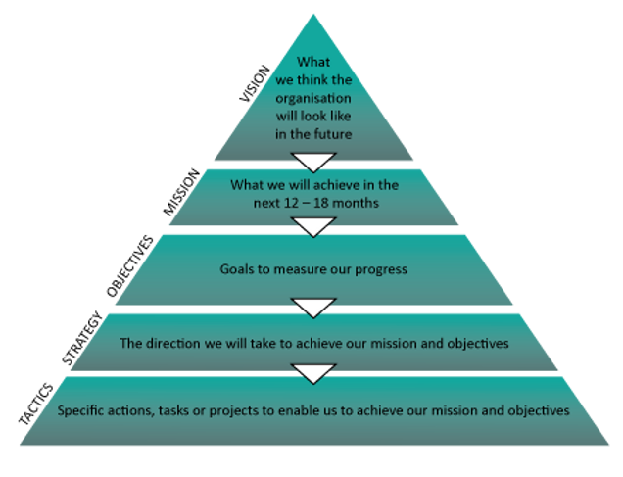
Approach
VMOST is the strategic method used to create the Strategic Plan template the IIBA provides to chapters.
VMOST Analysis is a tool that allows a business to evaluate its core strategies in terms of whether the supporting activities of that strategy are being carried out.
The VMOST analysis tries to answer that by looking at five core elements: vision, mission, objectives, strategies, and tactics.
https://brendanbroadhead.wixsite.com/vmost/what-is-vmost https://fourweekmba.com/vmost-analysis/

Slide 12



Approach
Applying your analysis skills in strategic planning will benefit you on your planning journey. As a team you'll determine a Vision and Mission for your chapter and use tools such as the SWOT Analysis to determine the competitive position of your team in the business analysis space and / or industry.
Vision
Mission
SWOT Analysis

Slide 13
Vision encompasses ideas that summarize where a chapter sees itself in the future.
Where will it operate?
Which target audience will it serve?
How will it position itself against the competition?
What does the chapter want to be known for?
The answers to these questions should inspire and challenge the chapter to do better without being unattainable.
The vision for the ABC Chapter is to be the organization of choice for all business analysis professionals in the Greater Fictitious City area for business analysis certification readiness, mentoring, learning and education, done in ways that create a more sustainable Chapter and better shared future that makes a difference in people’s lives and communities.
Example

Slide 14
The mission for the ABC Chapter is to create greater awareness of the business analysis profession by working towards recognition of the value of the business analysis discipline. The ABC Chapter is dedicated to bringing the Fictitious City Business Analyst Community together to help grow, connect, and evolve the profession of business analysis.
Mission is the series of steps that guide a business to carrying out its vision.
To change old and outdated ways of operating, missions must be adopted from the Board of Directors down to each Chapter member.
Example

Slide 15
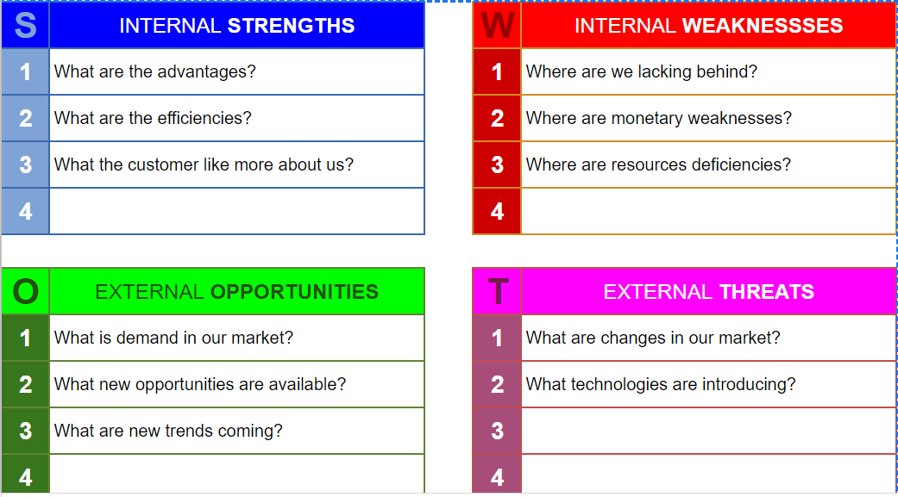
SWOT analysis is a framework used to evaluate a company's competitive position and to develop Strategic Planning. SWOT analysis assesses internal and external factors, as well as current and future potential by asking poignant questions, such as those to the right.
A SWOT analysis is designed to facilitate a realistic, fact-based, data-driven look at the strengths and weaknesses of an organization, initiatives, or within its industry.
Note: The organization needs to keep the analysis accurate by avoiding preconceived beliefs or gray areas and instead focusing on real-life contexts.

Slide 16
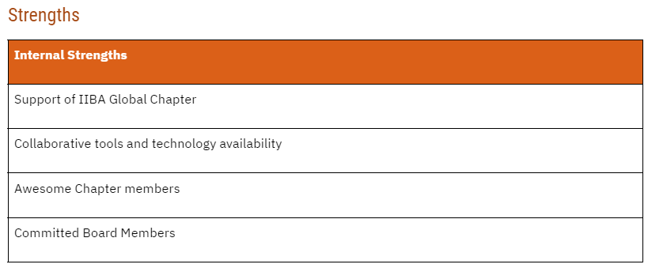
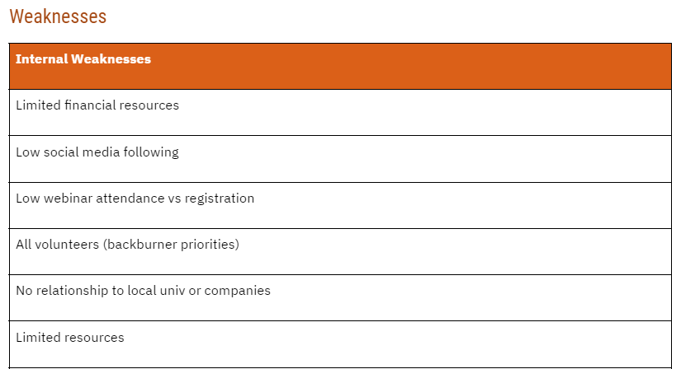
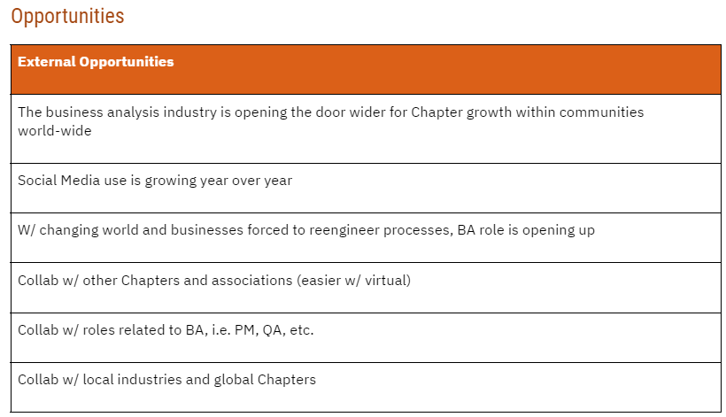
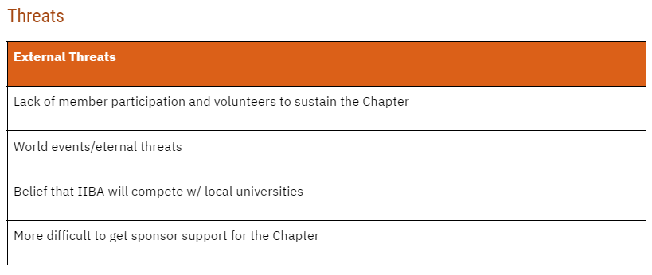
SWOT Example

Slide 17

Planning

Slide 18
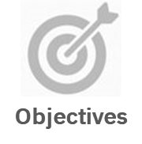

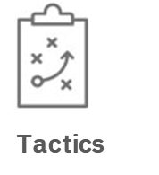
Purpose
Now it's time to dig into the details and build your plan.
Together you'll determine what from the below you'll employ to make your Vision and Mission come to life.
Strategies

Slide 19

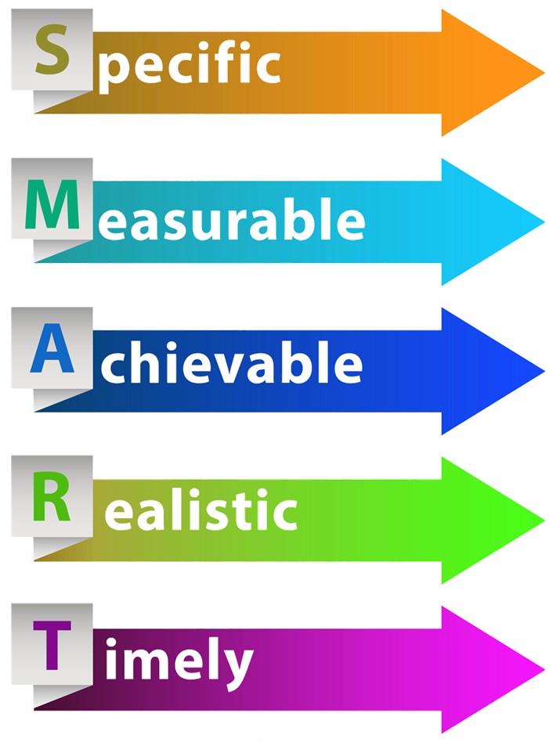
Planning
Objectives
Objectives define whether a mission has been accomplished, usually quantified in the form of key performance indicators (KPIs). To maximize the chances of meeting certain objectives, Chapters can adopt the SMART goal attainment strategy.
Objectives
Strategies
TEMPLATE
Tactics

Slide 20
SMART Objectives – A Closer Look
Specific
Consider the below six “w” questions:
Who is involved in achieving this objective?
What are you trying to accomplish, specifically?
When will this objective be accomplished? (more on this in the timely section)
Where are the relevant locations for this objective? (this may not always apply)
Why is this objective important to accomplish?
Which obstacles, limitations or requirements are involved in this objective?
Measurable
A measurable should answer questions like:
How much?
How many?
By what amount?
How will I know when it is accomplished?
Achievable
An achievable objective should consider the “how”:
How will I achieve this objective?
How realistic is this objective?
Relevant
Consider the below questions:
Is this objective applicable to the current (business, economic, social, etc.) environment?
Does this objective seem worthwhile?
Is this objective aligned to other adjacent efforts?
Am I the right person to reach this objective?
Timely
Consider the following:
When will I complete this objective?
What milestones will I accomplish and when?
What can I do today to get started?

Slide 21
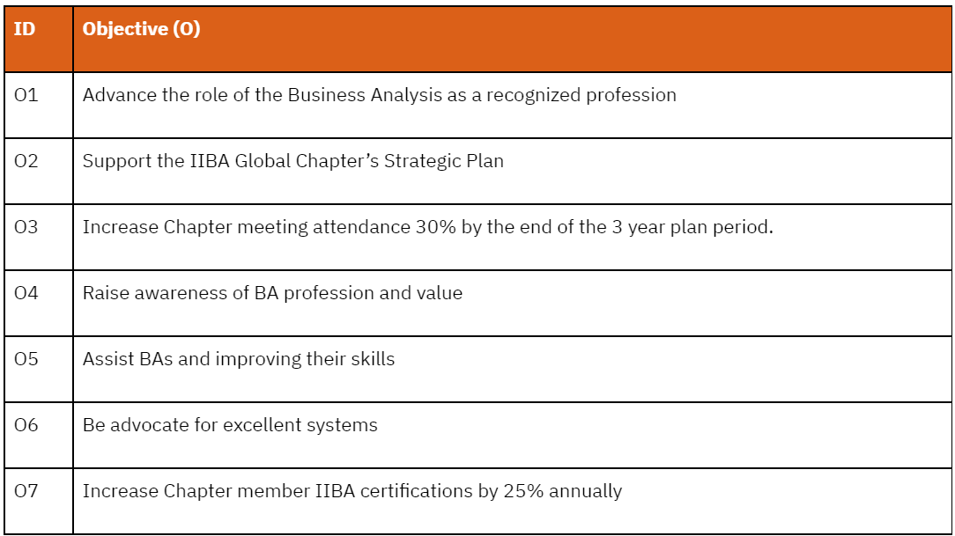
Objective Example
Use a simple id pattern that can be carried through your documents.

Slide 22
Planning
Strategies
Objectives
As objectives guide missions, so too do strategies guide objectives. If the goal of a taxi company was to increase revenue by $10 million annually, a potential strategy may include expanding the service into five new cities by the end of the year.
Strategies
Tactics

Slide 23
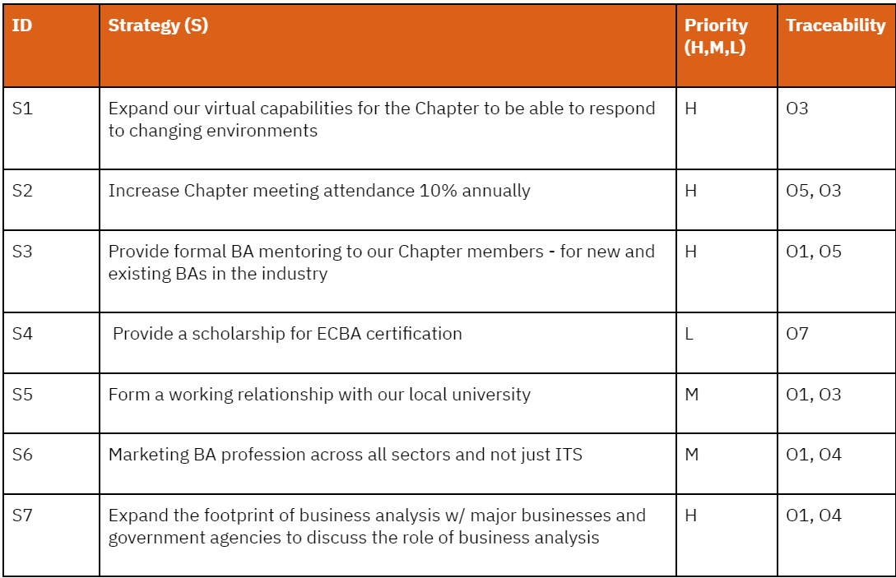
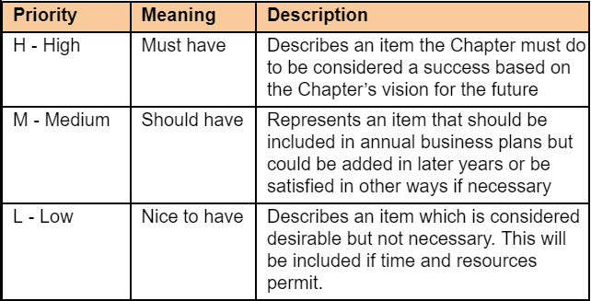
Strategies
As objectives guide missions, so too do strategies guide objectives. If the goal of a taxi company was to increase revenue by $10 million annually, a potential strategy may include expanding the service into five new cities by the end of the year. Example below:
Use a simple Priority Scale such as:
Strategies should be traced to one or more objectives that the strategy is meeting.

Slide 24
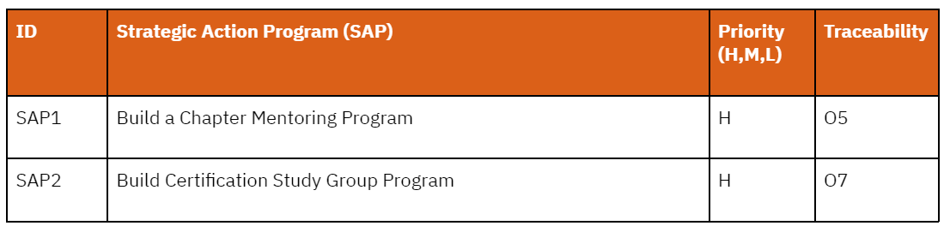
Strategic Action Programs
Larger programs the organization might create with defined leadership and goals to support one or more objectives, i.e., Chapter Mentoring Program, Sponsorship Program, Certification Program, Business Analysis Development Day Program, etc. The need for the program is typically defined in the Strategic Plan, but the supporting tactics will be defined by the program team once it’s established within the Strategic Plan period. Example below:
Strategic Action Programs should be traced to one or more objectives that the program is meeting.

Slide 25

Planning
Objectives
Strategies
Tactics
Tactics encompass the specific, low-level actions that are taken for strategies to be fulfilled.
In other words, what specific actions are you going to take to enable your strategies and strategic action programs.
Tactics
TEMPLATE
Click Here for Tactic
Sample

Slide 26
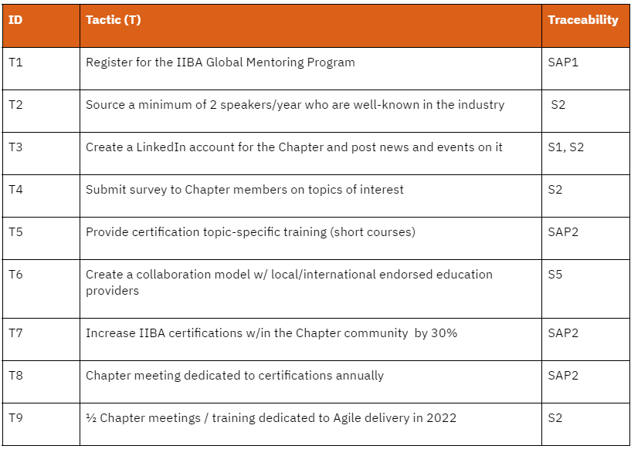
Tactics Example:
Tactics should be traced to one or more strategies or strategic action programs the tactic is aligned with.

Slide 27

Evaluation

Slide 28


Evaluation
There are typically two types of evaluations in Strategic Planning, Formative and Summative. The main differences are as follows:
In formative evaluation you assess the status of the chapter at any point in time to drive change in behaviors or programs, where with summative evaluation you measure the extent to which the outcome of your efforts align to the Strategic plan over time.
Formative Evaluation
Summative
Evaluation

Slide 29
Evaluation
Formative Evaluation
Shows what has or has not been completed to date. This type of evaluation can be undertaken at regular intervals as a form of developmental review.
Frequency/Criteria/Target
  How often, against which criteria, for whom, and with respect to which, if any, goals and policies will the initial evaluation occur? Will there be an initial evaluation only or a schedule of periodic evaluations?
Goals/Objectives
  What goals and objectives, as defined in this Strategic Plan, are progressing, and how well is the team achieving the goals at the point of evaluation?
Information Usage
  What will you do with the information you gather during the formative evaluation?
Move Forward Assessment
  What now needs to be done, what has to happen in the future, and what should you desist from doing at this stage?
Alignment
  To what extent does your progress so far align with the vision, mission and values espoused in the Strategic Plan?
Formative Evaluation
Summative Evaluation

Slide 30
Evaluation
Summative
Evaluation
Formative Evaluation
Summative Evaluation shows what has, or has not, been achieved insofar as the Strategic Plan is concerned.
Frequency/Criteria/Target
  How often, against which criteria, for whom, and with respect to which, if any, goals and policies will the final evaluation occur?
Reporting Evaluation
  To what extent has your operational plan and the various annual reports prepared addressed the Strategic Plan?
Data Management
  How can the data gathered when completing the summative evaluation be used for informing the next cycle of Strategic Planning?
Final Assessment and Management
  How valid are the tenets the team has operated under for the duration of the Strategic Plan? Do they still apply, and if not, why should they be revised?
Summative Evaluation
Note: some teams may prefer to maintain both assessment types in a single scorecard.

Slide 31
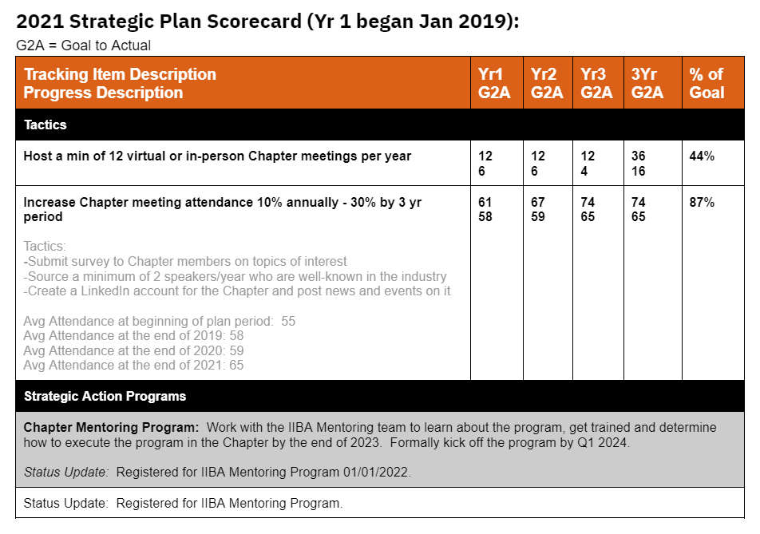
SCORECARD Example

Slide 32

Facilitation

Slide 33



Facilitation
Facilitation doesn’t come naturally to everyone. The hands, heart and head of facilitation skills involve the following:
Recommended Steps for
Facilitating a Strategic Planning Session
Agree on a session facilitator
Schedule the session w/ board and program leads
Prepare all session materials and select tools to be used in advance
Email materials to all attendees
Ensure engagement from all attendees during the session
Send draft of Strategic Plan to all attendees after the session for final review
Update and store the final draft of the plan to the Chapter's member-access document repository
Communicate Strategic Plan Summary to Chapter at large
Preparing
Designing
Moderating
Reporting
Curiosity
Trust
Flexibility
Neutrality
Self-Awareness
Tools & methods
Project Management
Reading group dynamics
TEMPLATE
Click for Sample Scorecard
What are facilitation skills and how to improve them?

Slide 34
Resources
Strategic Planning Session Guide:
https://www.iiba.org/globalassets/myiiba---only-secure-material/chapters/chapter-resources/strategic-financial-and-business-planning/strategic-planning-session-guide.pdf
Strategic Plan Template:
https://docs.google.com/document/d/1_VAc3YSHYWuPFZt0HmHjuWWg8pzq1Dus/edit?usp=sharing&ouid=113821677380438363164&rtpof=true&sd=true
IIBA Online Library (Facilitation Search):
https://iiba.skillport.com/skillportfe/main.action#search/440438e2-2c69-4a1c-8c33-5f4ca04d305b

